Slide 1
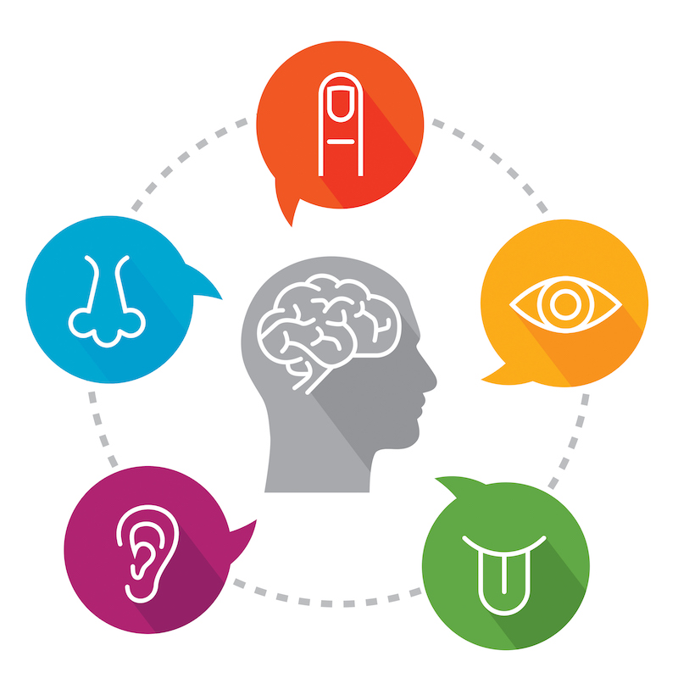
Multimodal
Learning
unleashing the
human memory
Dave Cohen, Oct 2023
Notes:
Hey everyone, My name’s Dave Cohen and this Brown Bag talk is about (TITLE)
The goal of this talk is to introduce some new learning and memory techniques. I’m hoping that you’ll find them fun and interesting and you’ll want to try them out.

Slide 2
Why this talk?
Question: what should people learn in an age of chatgpt?
Notes:
Learning, in general, has always been fascinating to me. These days, I’ve had to ask myself what we still need to learn and actually remember. When I chatted with AI about it, the bots reminded me that curiosity and creativity (which are both supported by learning and memorization) are more relevant than ever.

Slide 3
What we’ll explore
The state of learning today, how we got stuck on a narrow way of learning (text)
How multimodal memory techniques can broaden how we learn; make it more fun and efficient

Slide 4
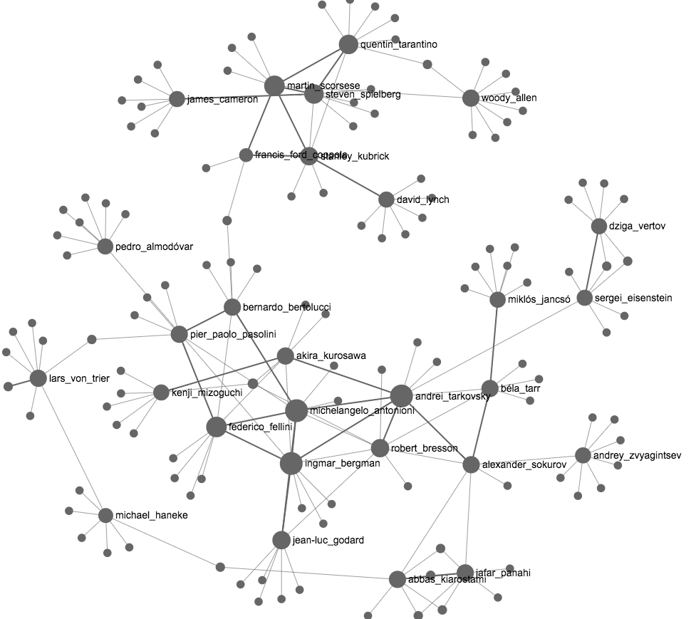
My story
How I'm Building My Second Brain
// big .md notes collection
Projects
[[how-to-x]]
[[how-to-y]]
x
[[all-about-x1]]
[[all-about-x2]]
Notes:
A while back, I discovered the “second brain” methodology of note-taking. The goal of a “second brain” is to create a digital network of knowledge - and that’s done by connecting notes. The more notes you create and link together (using “backlinks”), the more your network of nodes expands and frankly, the results just look really cool.
So, I did just that - I made summaries of books, articles, and podcasts. I was proud of my ability to be a human summarizer.
I read and re-read my hand-crafted notes but didn’t notice myself being able to recall things (that well or at all) given how much time I spent. You could say I hit a wall.

Slide 5
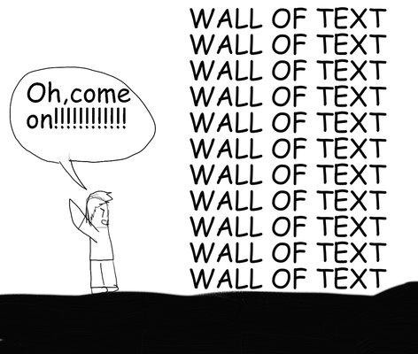
Notes:
A wall … of text. I wasn’t even close to being a kickass walking encyclopedia.

Slide 6
Rote learning takes up to 160 repetitions
~Rote Memorization and Alternatives to Learn Faster and More - A Tutor
Notes:
Looking back, by reading, and re-reading my notes, I was essentially trying to learn by rote.
(slide)
Our brains reserve resources for interesting events, they’re primarily concerned with survival. Just exposure to abstract concepts (in text form especially) isn’t nearly interesting enough to take up precious mental space.
So, clearly, that wasn’t working.

Slide 7
A picture is worth 1000 words
50% of our brains are visual
Notes:
I took a new approach…
I started drawing pictures of concepts I was trying to learn (click)
As we all know, a picture is worth a thousand words, and I was able to remember things a lot better.
I also remembered that 50% of our brains are involved in visual processing: https://www.imagethink.net/true-or-false-vision-rules-the-brain/
That’s a huge amount of brain capacity I wasn’t really utilizing.

Slide 8
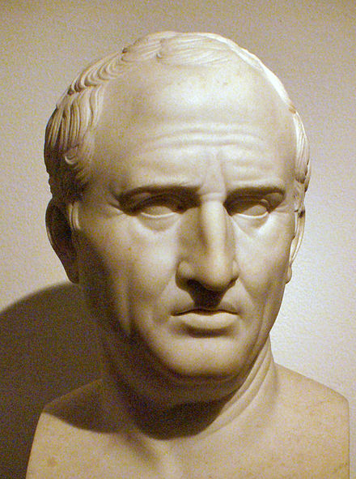
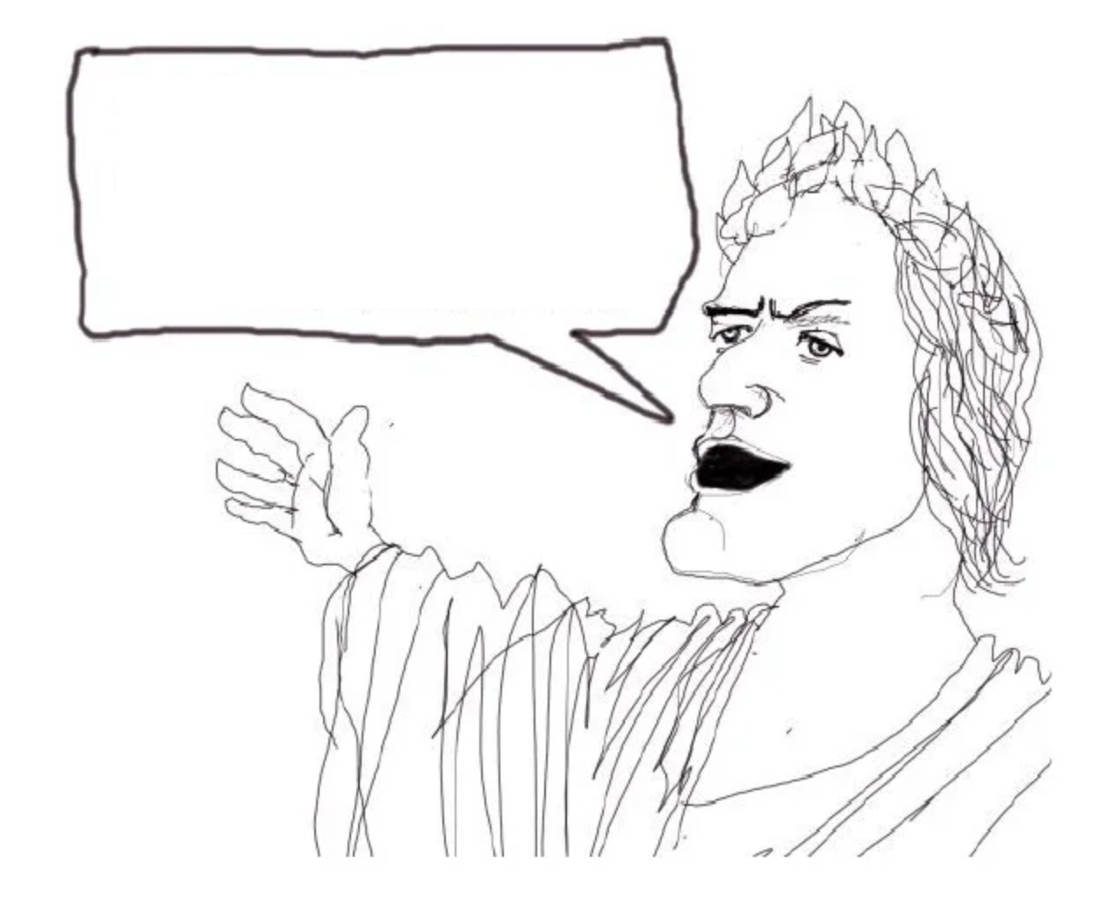
i am trained on all the current data
Ars Memoriae
2500 year old memory techniques
Notes:
As I dug further, I uncovered memory techniques that were used by the ancient greeks and romans. They were able to remember impressive amounts of information
They gave speeches from memory, engaged in lively debate, and demonstrated the potential of human memory. Books weren’t prevalent, so the main place human knowledge was stored was in people’s heads.

Slide 9
So, why is text the default?
Notes:
(slide title)
Text is convenient and storage-friendly - it’s just … how we communicate now.
Conversations start in Slack or email and then make things official with (Google Docs, and other text collaboration platforms)

Slide 10
question
answer
Text is the end result
Thinking benefits from going beyond text
Notes:
Let’s take a conversation with chatgpt for example. Text goes in as a question and we get an answer in text.
But what about the in-between bits - the thought processes behind coming up with the question and how we process the answer?
I see text as the end result. But it’s a handicap to think only in text.

Slide 11
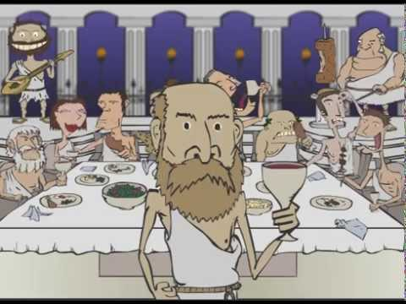
Imaginative powers - senses, faces, time, spaces
b. 2005
Notes:
So, let’s lay the groundwork for enhancing our memories and learning better as a result. We’ll first get in touch with our imaginative powers. By that, I mean conjuring something in the mind, usually associated with one of the 5 senses. Associating what we’re trying to learn with one or more of the senses helps create a richer, more vivid learning experience.
A significant part of the visual part of our brains can remember faces in great detail, so faces can be great learning aids.
We also tend to remember momentous times in our lives. This is a picture of my nephew who was born in 2005. (He looks way different now)
Another “sense” (as it were) is spatial memory - our brains are evolved to remember locations of important resources. A Greek poet in the 6th century BC used this fact to his advantage. He was having dinner with colleagues, left the building, and the next thing he knew, the building collapsed, killing everyone inside. He noticed that he was able to recall each person’s locations in the dining hall without having made an effort to do so. (This is the origin story of the Method of Loci, which I’ll talk about in a bit.)

Slide 12
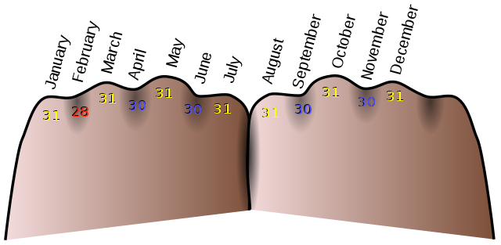
Mnemonics
September
April
June
November
= SAN-J(une)
Notes:
Let’s see some memory techniques which use our imaginative powers. Mnemonics, which you’re probably familiar with, are any conceptual device that helps us remember something.
The way I learned to remember which months have 30 days is through song and utilizes our auditory imagination.
That stuck with me really well but we can condense it into an
acronym - SANJ (as long as you differentiate between June and the other J months.) This adds a sense of taste to the mnemonic.
There’s also a visual and tactile mnemonic to remember that - using your knuckles and the spaces between them to represent the months.
These mnemonics all engage our senses which make it easier to remember what we’re trying to remember.

Slide 13
Elaborative Encoding
sensory, vivid, OUTLANDISH
something we already know
what we want to learn
Notes:
The next technique, Elaborative Encoding, uses mnemonics.
By elaborating new information with what’s already-established, it becomes easier to learn and recall this new information.
We’re linking the new to the old -
The link is something we already know and can recall easily, and is related conceptually to the new
The more sensory, vivid, wild, outlandish it is, the more effective it will be. This augmenting process makes it something our brain will be much more likely to pay attention to.
Let’s see an example (next slide)

Slide 14
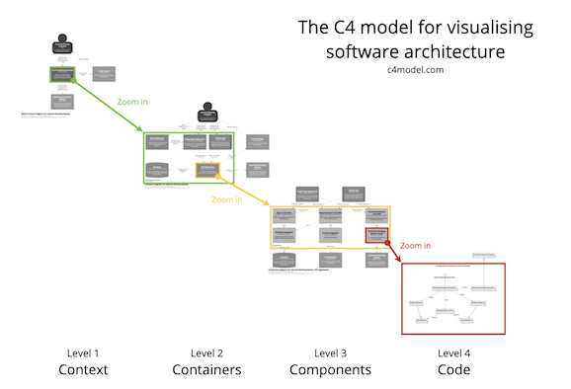
Elaborative Encoding Example
c4model.com

Slide 15
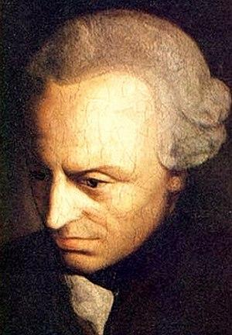
Elaborative Encoding Example
c4model.com
1. Context
Kant text
2. Container
Kant-ainer
🥤
📑
<b>HI!</b>
👷‍♂️💻
3. Component
Computer parts
4. Code
Code

Slide 16
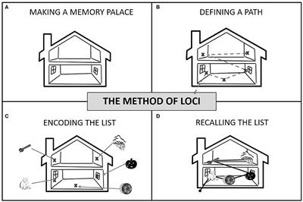
Method of Loci - Walking through a memory palace
Notes:
One of the ancient memory techniques used by memory experts today the Method of Loci - Walking through a memory palace. “The method of loci is a strategy for memory enhancement, which uses visualizations of familiar spatial environments in order to enhance the recall of information.” ~Wikipedia
(slide)
Image credit: https://www.monitask.com/en/blog/best-memorization-techniques

Slide 17
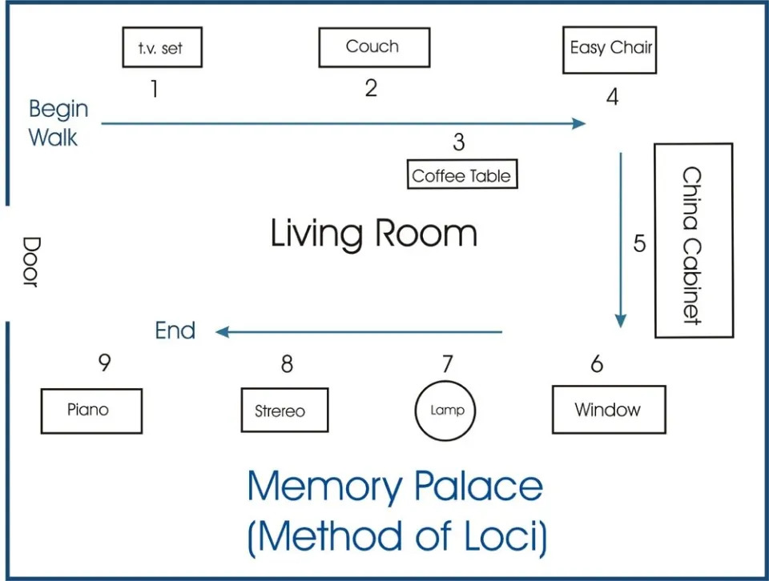
Notes:
Image credit: https://themdjourney.com/studying-with-memory-palace-in-medical-school/

Slide 18
<b>HI!</b>
🥤
📑
💻
Notes:
https://themdjourney.com/studying-with-memory-palace-in-medical-school/

Slide 19
Choosing memory palaces
Places you’re very familiar with:
Childhood home(s)
Places you associate with learning:
School
⭐️ Coding bootcamp
Street routes
Famous places
Fictitious places
…should have interesting spatial qualities for easy recall
Notes:
If you find memory palaces useful, it’s handy to have a large collection of memory palaces. A good starting place is…

Slide 20
Final thoughts
Learning this way is fun, engaging, and motivating.
It’s personalized and creative, not just text on a page or screen.
You’ll learn more, faster:
you’ll use more of your brain (>50%)
less time re-reading (160x faster)
1 picture, 1000 words (1000x more efficient)
Notes:
So, wrapping up, I think…
(Not just text) When I was in school, I don’t recall learning how to learn and these techniques would’ve been extremely helpful.
I think you’ll learn more faster by drawing, generating mnemonics, and using a memory palace. You’ll go from…

Slide 21
Thank you 🙏
Questions?

Slide 22
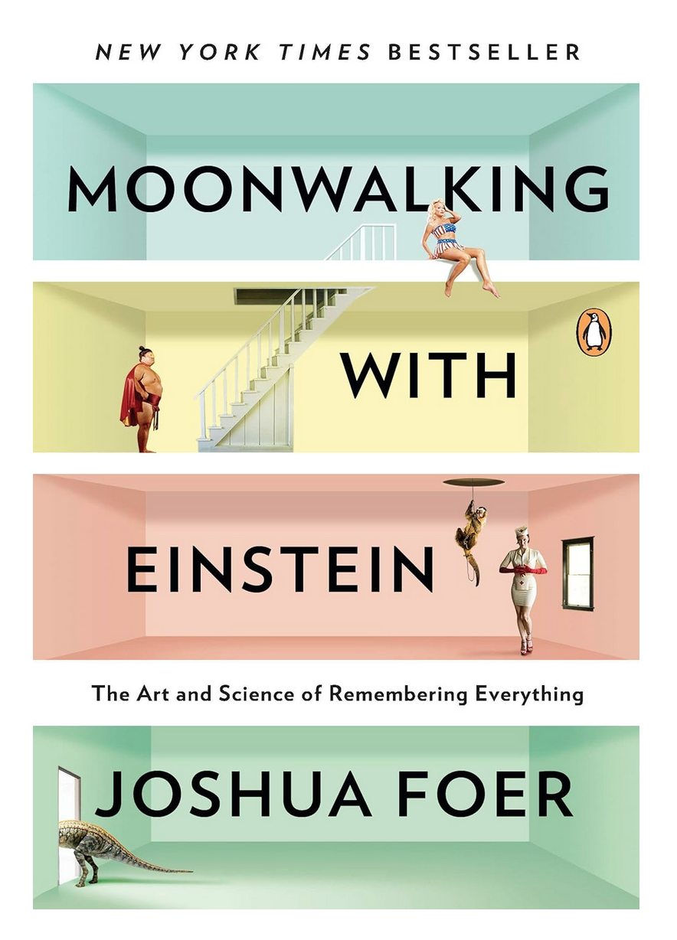
Notes:
Moonwalking with Einstein: The Art and Science of Remembering Everything by Joshua Foer

Slide 23
Appendix

Slide 24
FAQs
Does memorization indicate you’re not learning deeply enough?
How do you memorize more than 10 things?
How do you memorize numbers?
What about visual vs auditory vs kinesthetic learners?
What should I learn?
What about spaced repetition tools like Anki?
What about project-based learning?

Slide 25
Resources
Memorization / Learning
Moonwalking with Einstein: The Art and Science of Remembering Everything by Joshua Foer
WorkLife with Adam Grant: How to remember anything | TED Talk
How to Build a Memory Palace | Art of Memory
Mnemonic - Wikipedia
Elaborative Encoding - Wikipedia
Method of Loci - Wikipedia
Studying with a Memory Palace in Medical School - TheMDJourney
Best Memorization Techniques For Professionals: Better Memory

Slide 26
Resources
Integration
Integrating Sweep Picking With Other Techniques | Wizard of Shred
https://en.wikipedia.org/wiki/Meaningful_learning
https://en.wikipedia.org/wiki/Integrative_learning
https://en.wikipedia.org/wiki/Interdisciplinarity
https://en.wikipedia.org/wiki/Deeper_learning

Slide 27
Resources
Visualization
What is Visual Learning? | Presentation Guru
15 Visualization Techniques To Help You Achieve Your Goals | Indeed.com
3 Effective Visualization Techniques to Change Your Life | Psychology Today
Huberman Lab, Science-Based Mental Training & Visualization for Improved Learning (Podcast)
Comprehension
Toastmasters, Aristotle, and the Essential Art of Rhetoric | The Art of Manliness (Podcast)
The Art of Manliness, Beyond Lazy Learning — The Keys to Gaining and Retaining Knowledge (Podcast)

Slide 28
Resources
Motivation
https://supermemo.guru/wiki/Pleasure_of_learning
Book Summary: Drive by Daniel H. Pink | Sam Thomas Davies
The Pathless Path (Paul Millerd) - Summary, Notes & Review - Aseem Thakar
Other
The C4 model for visualising software architecture
Guitar Chord Finder | oolimo.com
Essentialism by Greg McKeown - Summary & Notes
Steven L. Franconeri - Faculty - Kellogg School of Management - Courses - Visualization for Persuasion

Slide 29
How I'm Building My Second Brain | scraggo.com

Slide 30
Example: The chapters of Essentialism, by Greg McKeown
IV. BSPFFB
III. CDUEL
🐻📈 💻
🕶
😴
I. LCDT
II. ELPSS
Les
Notes:
Essentialism is a non-fiction book written to help people determine what’s essential in their businesses and personal lives. Each quadrant in the memory palace represents a section of the book, each letter is the first letter of a chapter title. The imagery helps me recall the information in each chapter.
—
Overview of the book
The book is divided into 2 sections, "Essence" and "3 Steps of the Essentialist method"
Part 1: Essence - Chapters 1-4.
- > What is the core mindset of an Essentialist?
- 1 - Less, but better
- 2 - Choose: realize you always have choices
- 3 - Discern: 80/20
- 4 - Trade-offs: embrace the consequences of less, go big on what matters
Parts 2-4: 3 Steps of the Essentialist method
Part 2: Explore - Chapters 5-9
- > How can we discern the trivial many from the vital few?
- Thoughtfully evaluate choices
- 5 - Escape: disconnect to make room to find what's essential
- 6 - Look: keep a regular journal
- 7 - Play: explore what lights you up, acknowledge that's essential
- 8 - Sleep: "protecting the asset" is more difficult than running yourself ragged
- 9 - Select: use minimum and _extreme_ criteria
Part 3: Eliminate - Chapters 10-14
- > How can we cut out the trivial many?
- Eliminate what you don't love, isn't important, etc. What would you pay _now_ for the old shirt in your closet?
- 10 - Clarify: define an _Essential Intent_ with concrete action built into it
- 11 - Dare: Say "No" firmly, resolutely, gracefully. Fosters respect
- 12 - Uncommit: acknowledge sunk cost fallacy, status quo bias, etc
- 13 - Edit: cut, condense, correct, edit less / let things happen
- 14 - Limit: freedom through setting boundaries and creating social contracts
Part 4: Execute - Chapters 15-20
- > How can we make doing the vital few things almost effortless?
- Turn the mindset into a system and make every choice an essentialist choice.
- 15 - Buffer: extreme preparation for when things go wrong
- 16 - Subtract: Theory of constraints: improve the least efficient part of the system
- 17 - Progress: celebrate small wins, make that an "atomic habit"
- 18 - Flow: make your essential intents automatic through your routine
- 19 - Focus: figure out what's important _now_, consider the big picture
- 20 - Be: joy is a result of making essentialism core to your life

Slide 31
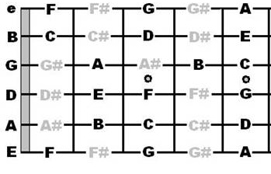
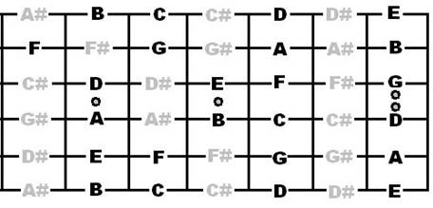
Practicing guitar without the guitar
Notes:
If there are any guitarists in the audience, this diagram has helped my students and I get more familiar with the notes on the fretboard. You can get mental “reps” in even without a guitar at hand.
MORE DETAILS
While Visualization is not a replacement for real-life practicing, adding mental “reps” in solidifies what you’re learning and makes recall faster. Not only can you actually build muscle using visualization (seriously!), you can practice guitar effectively by conjuring the instrument in your mind and imagining hands and fingers playing it.
When I mentally rehearse the guitar, I conjure the fretboard in my mind, visualize my left-hand fingers moving across it, and my right-hand plucking the appropriate strings. If I want to practice note-recognition, I label the notes as I go. I might isolate my left or right hand if I want to focus on either.

Slide 32
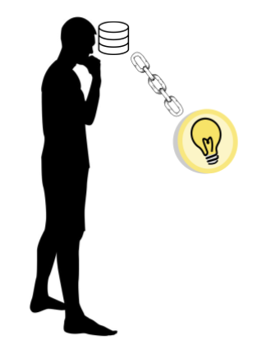
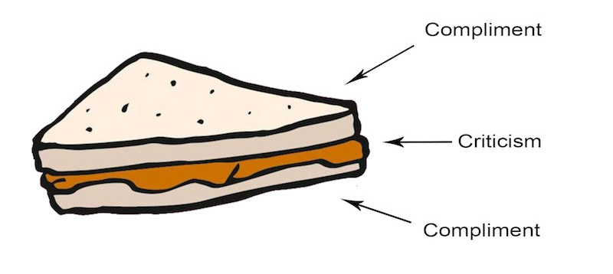
Integration
“Whenever you learn something new it's very important that you spend time integrating it with what you already know.”
~Claus Levin, the Wizard of Shred Integrating Sweep Picking With Other Techniques
Old
New
Old
Notes:
Years ago, I came across this concept known as “Integration” in a blog by a guitar teacher I knew as “The Wizard of Shred”. (quote)
He spoke to a problem I had, which was being unable to play the licks and the riffs I was learning in my own improvisations. Discovering Integration was the beginning of me becoming fascinated with learning techniques.
In the diagram, we have someone with stored knowledge, and we always want to link the new knowledge back to it. You can kind of think of it like a sandwich, recall something you know, relate it to something you’re learning, and bring it back to that thing you know.

Slide 33
Imaginative powers - using the mind’s eye/ear/etc.
The "pseudo-reality in one’s imagination can be so convincing that it can have unexpected effects on the physical body.”
~Marisa Brook, The Science of Mental Fitness
🎸 Increasing skills (music, etc)
💪 Building muscle
🤕 Pain management
☺️ Relaxation
Notes:
So, let’s lay the groundwork for enhancing our memories and learning better as a result. We’ll first get in touch with our imaginative powers. By that, I mean conjuring something in the mind, usually associated with one of the 5 senses. I just mentioned how much of the brain is dedicated to visual processing, but we can take advantage of all 5 senses to create a richer, more vivid learning experience.
Let’s hear about the power of the mind (quote)
Some of these effects including:
Mental practice isn’t a substitute for the real thing, but doing it can maintain or increase your musical skills. Same with exercise, it can actually help build or maintain muscle, which is amazing.
As for a mind-blowing health benefit example: There was a study done on improving the pain management for patients with severe burns. Playing a video game that explored icy worlds helped them lower their skin temperature and their pain was easier to manage as a result. Amazing.
Finally, simply visualizing yourself being in a happy place conjures good feelings - being happy helps you learn more effectively.

